Slide 1

WELCOME TO MY CLASS
SỞ GD & ĐT HÀ NỘI
CÔNG TY CỔ PHẦN
GIÁO DỤC VÀ ĐÀO TẠO VICTORIA
SỞ GIÁO DỤC VÀ ĐÀO TẠO HẢI DƯƠNG
HAI DUONG EDUCATION AND TRAINING DEPARTMENT
SỞ GD & ĐT ĐÀ NẴNG
CÔNG TY CP GD&ĐT VICTORIA
UNIT 6 : WHERE’S YOUR SCHOOL? LESSON 3.

Slide 2








VUI HOC TIENG ANH
1.
Where’s your school?
C
A. It’s Nghia Dao commute
.
B. Your school is in Nghia Dao District
C. It’s in Nghia Dao commute
1
2
3
4
5
6
7
8
9
10
Notes:
1 phương án ko xuất hiện trong video

Slide 3

VUI HOC TIENG ANH
2.
What class are you in?
A. I’m class 4C.
B
B. I’m in class 4C.
.
C. I in class 4C.
1
2
3
4
5
6
7
8
9
10

Slide 4
VUI HOC TIENG ANH
3.
Where’s Peter’s school?
B
A
It’s Nguyen Du Primary School.
.
It’s in Nguyen Du Street
B
It’s Nguyen Trai Street
C
1
2
3
4
5
6
7
8
9
10

Slide 5
VUI HOC TIENG ANH
4.
What class is Phong in?
A. It’s Nguyen Du street
C
B. I’m in class 4A.
.
C. He’s in class 4A.
1
2
3
4
5
6
7
8
9
10

Slide 6
VUI HOC TIENG ANH
5.
Order the words.
.
are
in
class
they
What
1
2
3
4
5
6
7
8
9
10

Slide 7



Slide 8
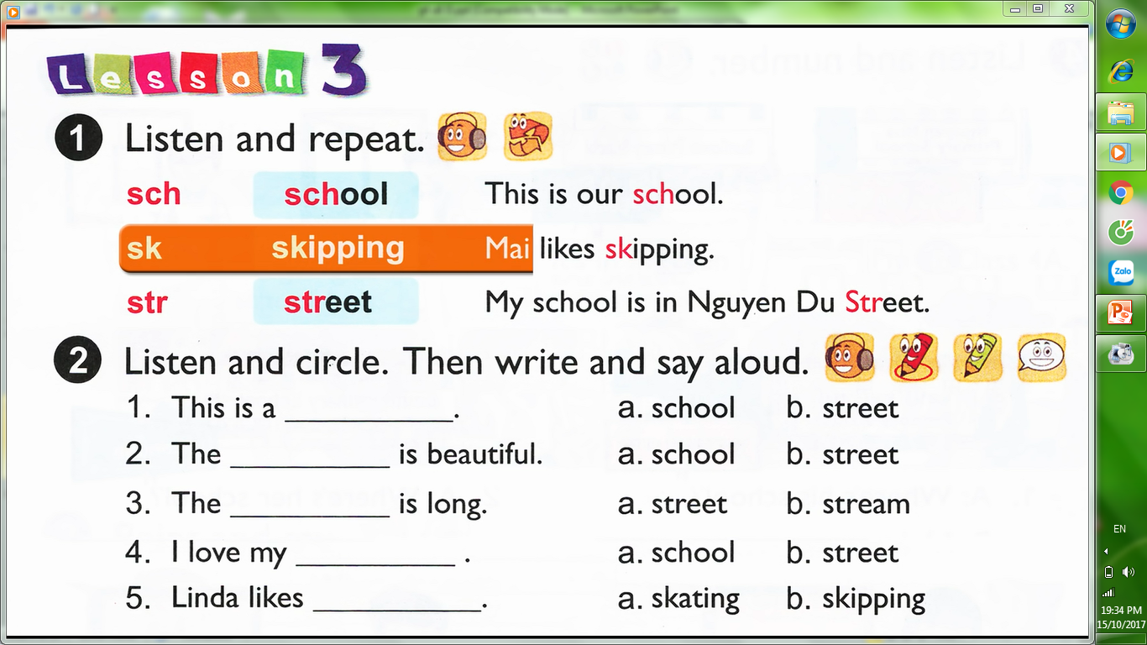

s
ch
sch
school /sku:l/
This is our school.
ŋ/
s
k
sk
skipping /skipi
Mai likes skipping.
s
tr
str
street /stri:t/
My school is in Nguyen Du Street.

Slide 9
school - bag , school - bus , school - day, school - yard , scholar , schoolboy…
sch
sk
skate , shirt , sky , skill , skin…
stream , strong , strict , stress ,
struture…
str

Slide 10
street
street
stream
school
skating
.
Notes:
y/cau hs doc truoc cac lua cchon

Slide 11
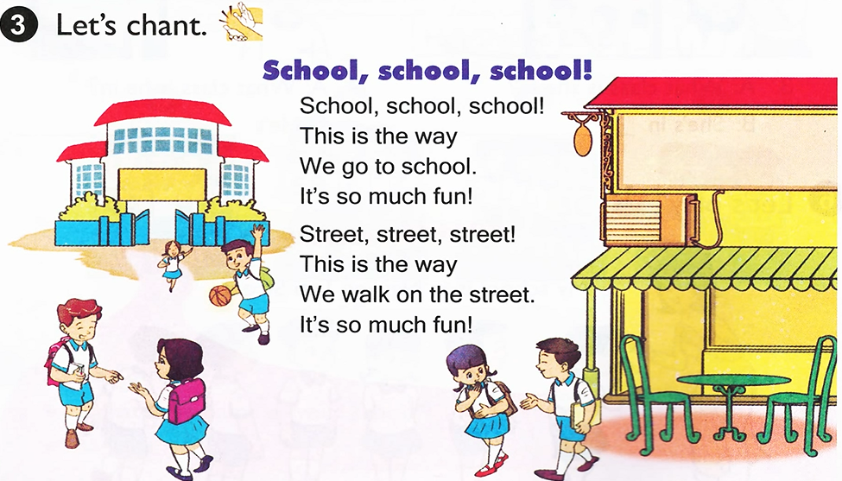
Notes:
Gach chan tu bat dau bang sch, str

Slide 12


.

